Slide 1
Well being wednesday
Our assembly on resilience

Slide 2
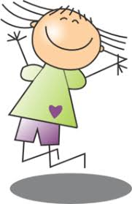
Good morning
I hope that everyone is well.

Slide 3
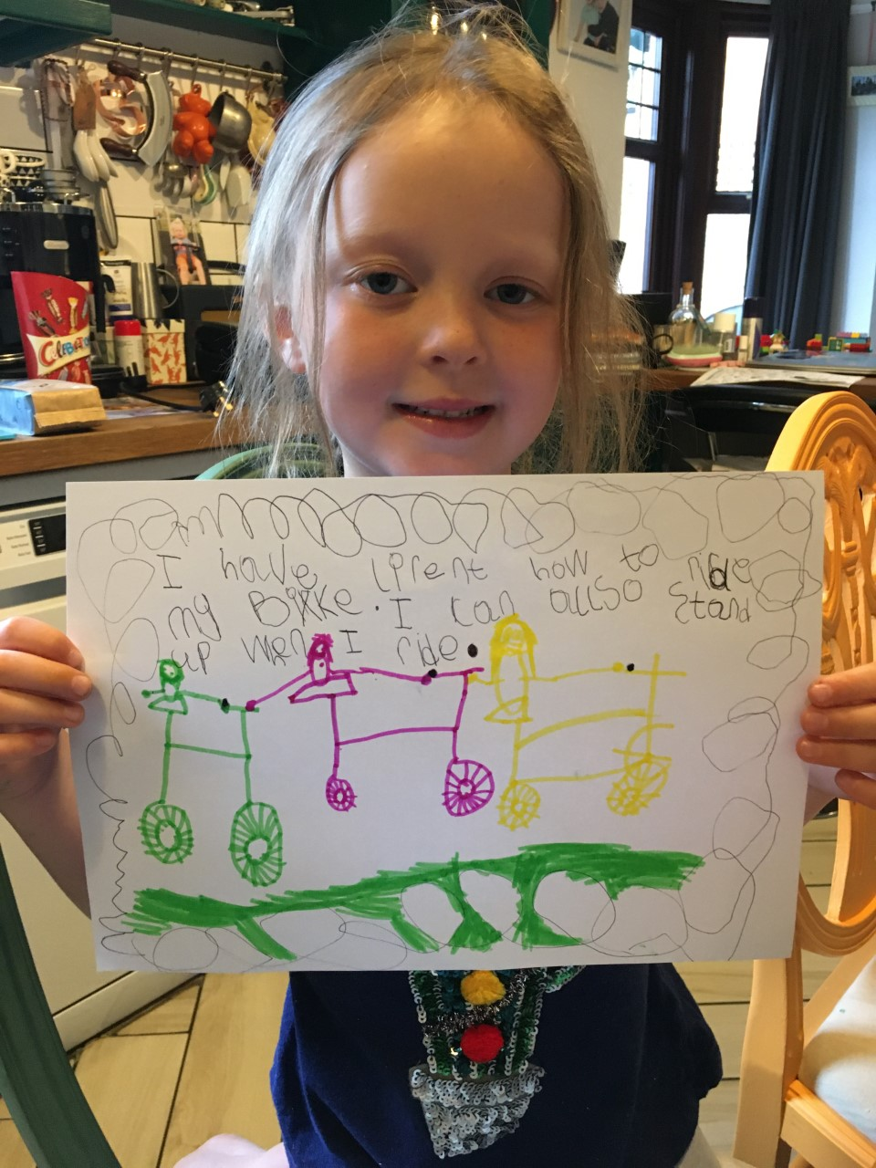
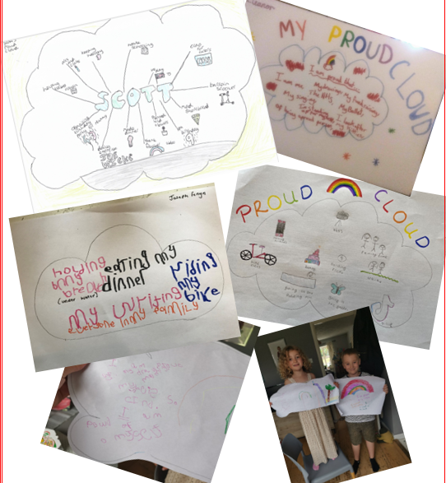
Well done for doing some amazing learning!

Slide 4
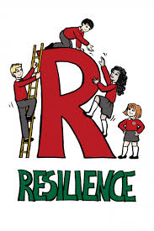
Our well being Wednesday theme is…

Slide 5
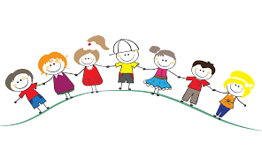
Resilience means…
Never giving up, no matter how tough it gets.

Slide 6
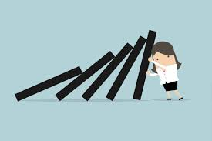
We need a lot of resilience at the moment.

Slide 7
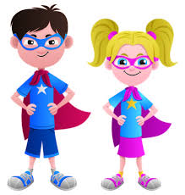
You have all become super people!

Slide 8

And…

Slide 9

So your well being Wednesday activity today is all about…

Slide 10
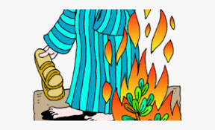
THE STORY OF MOSES – a very resilient man!
When Moses grew up, he looked after sheep. One day he was watching sheep when he noticed a bush that was on fire. The bush was bright red, its branches crackled orange and red. The strange thing was that the bush didn’t burn up. And then there was a voice telling him to take off his sandals. The voice told Moses that he had called him to do a special job – to lead God’s people out of Egypt to freedom.

Slide 11
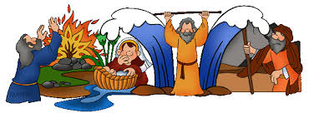
Moses didn’t believe he could do that. But God told him that he could because God would give him every thing he would need to do it. He told Moses to throw down his stick. The stick turned into a wriggling snake. God told him to pick it up. Moses was scared but he reached out to it and as he touched it the snake turned back into his stick. Somehow Moses knew that God was with him and would help him with the really important job.

Slide 12
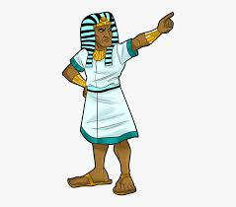
Moses and his brother Aaron went to the king of Egypt called the Pharoah and asked that he let the Hebrew people go free. The Pharoah said ‘no, no, no!’. Not just once but time and again. Moses kept going back to him. Sometimes he felt like giving up but somehow God gave him the strength to keep going back.

Slide 13
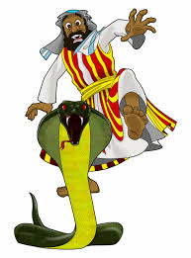
Every time the Pharaoh said ‘no no no’ some really nasty thing happened to the Egyptians. Things like lots of frogs, lice, diseases to crops, hailstones and all kinds of horrid things. But Moses kept going back and eventually the Pharoah agreed to let them all go. The Hebrew people quickly packed their bags, grabbed some food and set off.

Slide 14
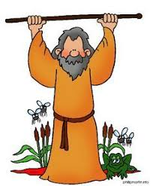
The people left quickly and it was just as well. They reached a sea and wondered how they were going to get through it! Then they heard the Egyptian army coming behind them. They had to get across the sea. Moses bravely held up his stick and the waters parted so they could all travel through to the other side. The people were free at last!

Slide 15
The journey took a very long time, lots and lots of years. The people, and Moses became older and more tired. But still Moses didn’t give up and one day they saw it! The Promised land, the place God had promised to give them.

Slide 16
A prayer…
Loving God thank you that you are always with us like you were with Moses. Please help us to be strong and resilient even when things are really hard. Amen

Slide 17

And now the end of last week’s story…
REMEMBER TO BE PROUD AND RESILIENT.

Slide 18
So in the end monkey never gave up. He was resilient and found his parsley.
Have a great day everyone!

