Slide 1
WELL BEING WEDNESDAY
Laughter

Slide 2
Welcome to our special assembly.
Thank you to everyone for their amazing learning over the last week.
You have all been superstars!

Slide 3

Our assembly this week is all about…
LAUGHTER!

Slide 4
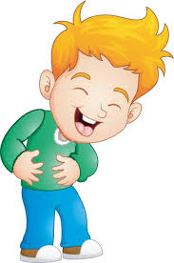
Laughter
Things are really tough at the moment, and it is important that we laugh and smile, to keep ourselves going!

Slide 5
Laughter is contagious.
Once someone starts laughing it is hard not to smile and join in. Just watch this clip.
https://www.youtube.com/watch?v=L49VXZwfup8

Slide 6
So hopefully you are smiling now!
Laughter is good for you!
Laughter relaxes the whole body. A good, hearty laugh relieves physical tension and stress, leaving our muscles relaxed for up to 45 minutes afterwards.

Slide 7
Laughter is good for you!
Laughter boosts the immune system. Laughter decreases stress hormones and increases immune cells and infection-fighting antibodies, thus improving your resistance to disease. In other words, it helps you to stop being poorly!

Slide 8
Laughter is good for you!
Laughter helps us to bond with other humans and build stronger communities. Shared laughter can be a great experience, and laughter can often be infectious.

Slide 9
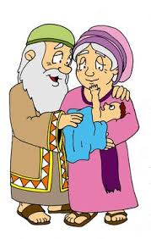
Laughter is even important in the Bible.
In the book of Genesis God tells Abraham and Sarah that they are going to have a child. Sarah is too old to have a child and when she hears what God has said she laughs. This laughter is so important that they call their child Isaac, as the name means ‘laughter’.

Slide 10
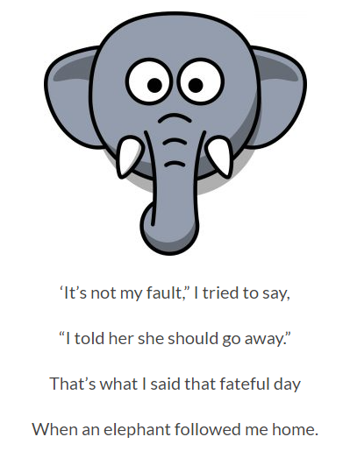
Stories and poems make us smile!

Slide 11
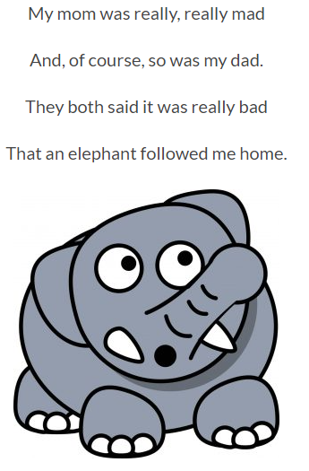

Slide 12
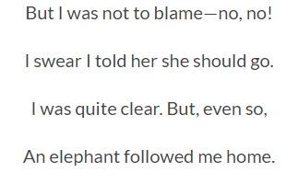

Slide 13
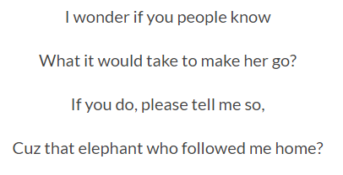

Slide 14
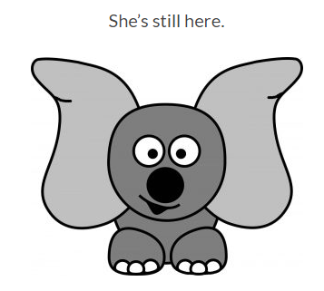

Slide 15
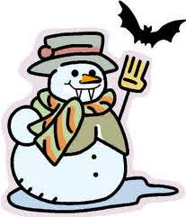
Our activity today is to write or draw a joke book.
What do you get when you cross a snowman and a vampire?
Frostbite!

Slide 16
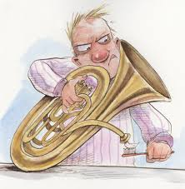
What musical instrument is found in the bathroom?
A tuba toothpaste

Slide 17
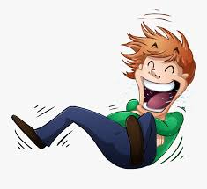
I am really looking forward to seeing your joke books!

Slide 18
Prayer for today…
Loving God, we thank you for the gift of laughter.
May our laughter never be unkind.
But help us to laugh with joy, and bring joy to others.
Amen.

Slide 19
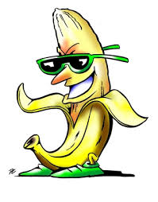
Have a great day!
Why do bananas have to put on sunscreen before they go to the beach?
Because they might peel!

