Slide 1
WELL BEING WEDNESDAY
Saying THANK YOU

Slide 2
Welcome to our special assembly.
Thank you to everyone for their amazing learning over the last week.
You have all been superstars!

Slide 3
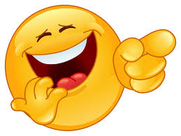
Our assembly this week is all about…
Saying
‘Thank you.’

Slide 4

We have said thank you a lot recently to our key workers

Slide 5
The loving cat
Wayne was very lonely. He had no-one to play with. No friends lived nearby. What could he do? Just then a little cat came in through the window and jumped down onto the floor. “Shoo! Shoo!” said Wayne. It was then that Wayne could see that it was limping. “Ag, shame!” he said. “What is the problem?” He picked up the little cat and then he found that it had a sore on its foot.

Slide 6
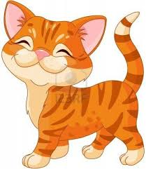
“Wait a bit. I know what I can do. I’ll put some ointment on it.” He carried the cat into the bathroom where he found the ointment and put some on the cat’s foot. The cat began to purr. It rubbed itself against his legs to say ‘thank you’. When the family had supper he fed the cat and when he went to bed it jumped up onto his bed and slept there all night.

Slide 7
The next morning his mother said, “You know Wayne, that is not your cat and some people might be very worried to have lost their cat. You should go to see the new people who have moved in next door and ask if they know anyone who has lost a cat. Wayne picked up the little cat and went next door. He knocked on the door. Before he could ask if anyone had lost a cat, the little boy who answered called out, “Mommy, Mommy, here is someone with my cat!” He held out his hands to take the cat. He stroked it and hugged it. “I am so happy to have my cat back. I thought that he had run away and that I would never see him again.”

Slide 8
Just then the mother came in. “Oh, thank you so much for finding our cat. A dog bit it and it ran away. I see that you have been very kind to him. You are welcome to come and play here. Thank you so much for finding him.”
Because Wayne was kind he is now welcome to play next door.

Slide 9

I wonder how many times Challenge.
I wonder how many times you will say ‘Thank You’ today?
Keep a count of the number of times that you do.

Slide 10
Saying thank you
Apparently, on average most people say ‘thank you’ eight times a day.
That does not sound a lot to me.
I hope that when you keep count you say ‘thank you’ at least 20 times a day!

Slide 11
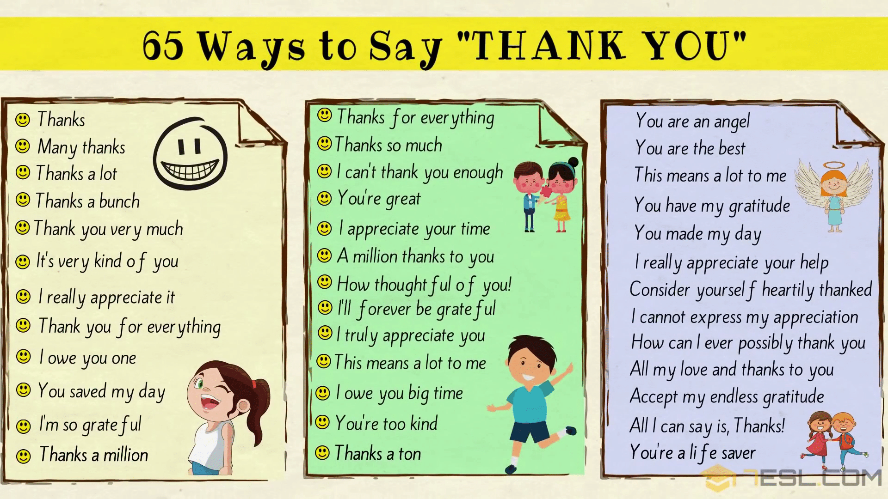
Try saying some of these today…

Slide 12

A prayer for today
Dear God,
We thank you for all of the wonderful things around us.
Help us to be kind, and to remember to always say ‘thank you.’
Amen

Slide 13
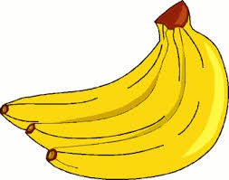
Have a great day!
Q: How do you show bananas your gratitude?
A: By saying “thanks a bunch!”

