Slide 1
Nottingham Castle On Fire
After King Charles I was executed after the Civil War, the original Nottingham Castle was destroyed.
It wasn’t until 1679 that the current building was built for the Duke of Newcastle.
We then have to jump forward to 1831 for the next big episode in the Castle’s history.
During a large riot in the city, some people set fire to the Castle…

Slide 2
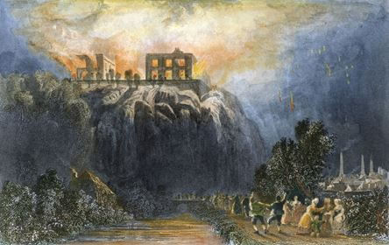

Slide 3
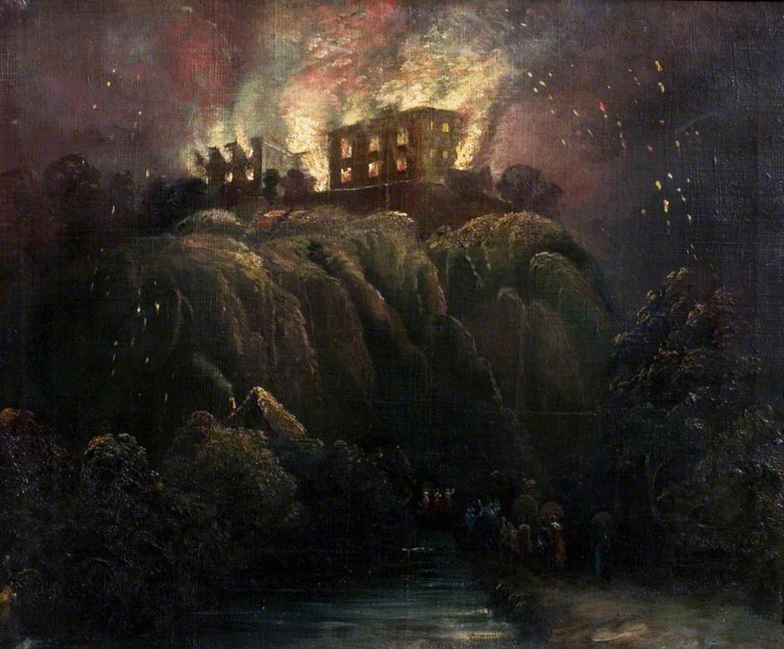

Slide 4
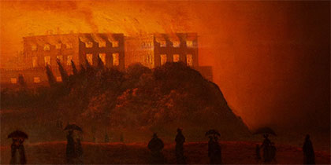
View of the Castle Rock in the distance at night: a dark canvas with only the orange glow around the hill. In the foreground are figures in silhouette watching the blaze. Trees are outlined against the blazing castle.

Slide 5
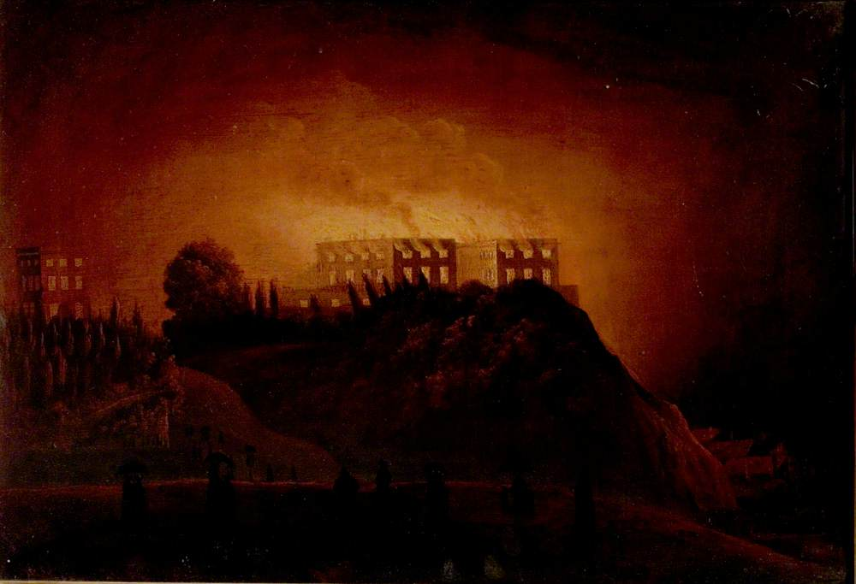

Slide 6
Your Task
The burning of Nottingham Castle has been recreated many times by local artists.
Now it is your turn. Use the paintings as inspiration to create your own piece of art showcasing this famous event.
You could use paints, pastels, collage or alternative materials of your choice.

