Slide 1
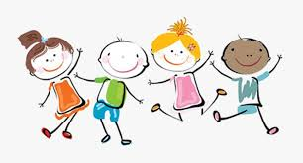
WELL BEING WEDNESDAY

Slide 2

I am so proud of you because you are all such wonderful children!
Thank you!

Slide 3
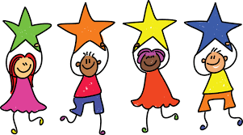
You should feel very proud of yourselves!

Slide 4
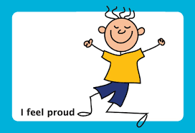
So this week we are going to think about feeling proud.

Slide 5
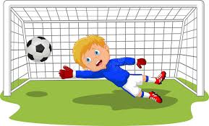
When I was at school I played for the football team, in goal, just once!
I felt so proud!

Slide 6
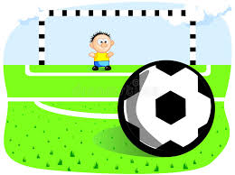
OK, we lost
8 v 0 but I was still proud!!!

Slide 7
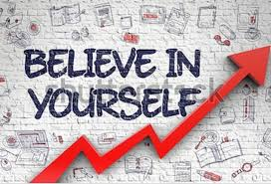
There are some great books that you can read about being proud and self steem.

Slide 8

This classic picture book is about a girl named Grace, whose favourite pastime is writing her own stories to act out for her family and friends. When her school holds auditions for Peter Pan, the talented Grace is heartbroken to hear that she can't be Peter because she's a girl — and black. It's Grace's grandmother who teaches her that if she has enough confidence and determination, she can be whatever her heart desires.

Slide 9
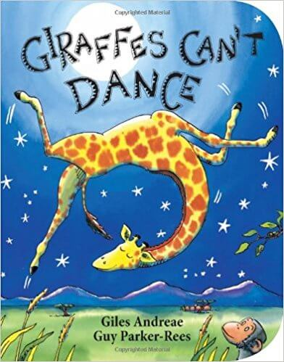
In this best-selling picture book by Giles Andreae, tall and awkward Gerald the giraffe wants nothing more than to join in on the annual dance party. But when the other animals make fun of Gerald's clumsiness, he becomes self-conscious. It's only when Gerald embraces his differences that he truly learns that "we all can dance . . . when we find the music that we love."

Slide 10
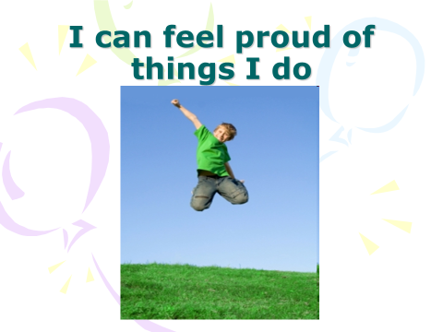
PROUD

Slide 11
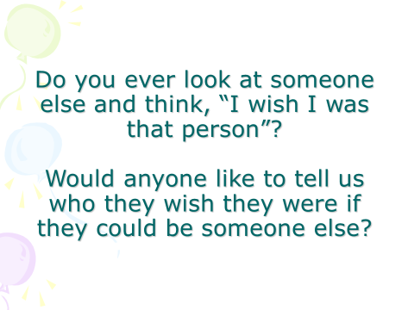
PROUD

Slide 12
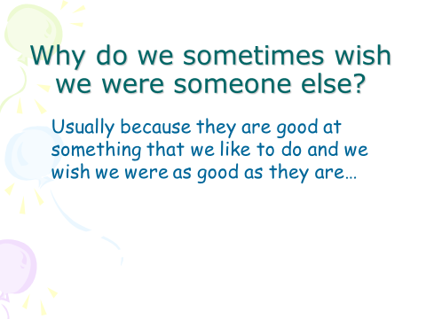
PROUD

Slide 13
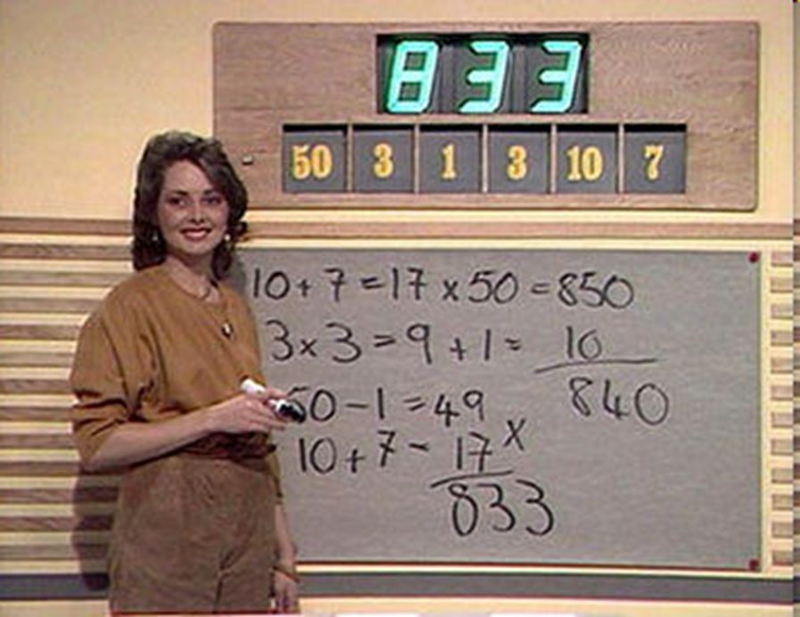
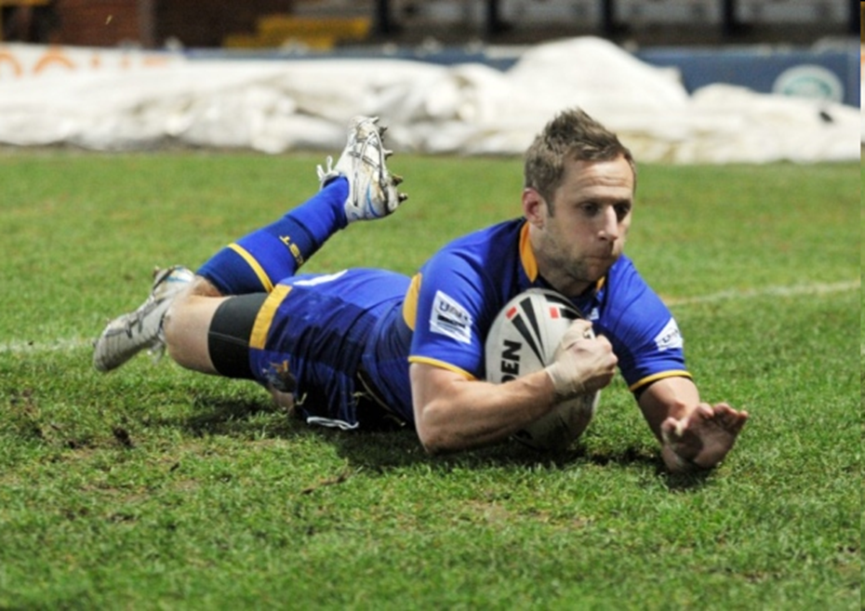
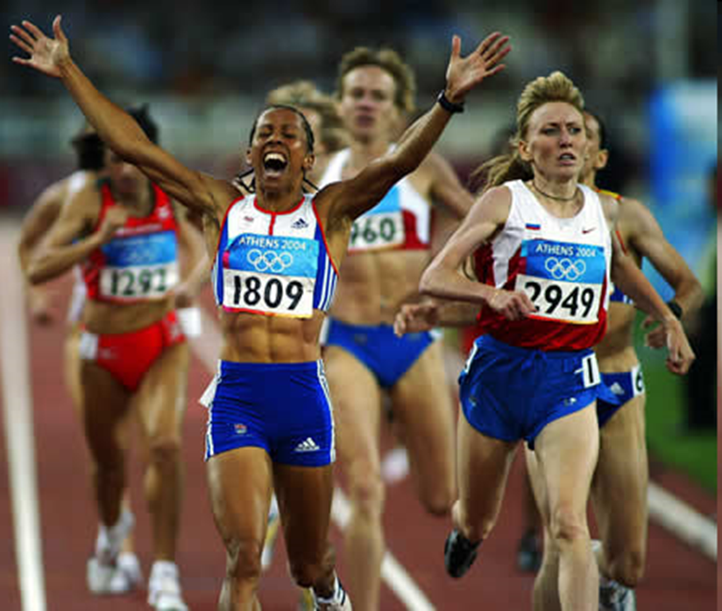
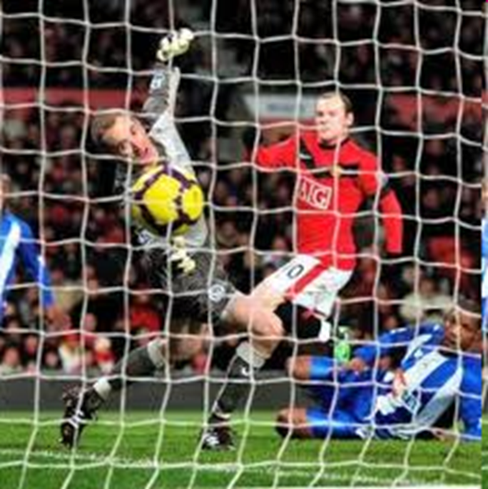

Slide 14
The story of Bobby Charlton

Slide 15
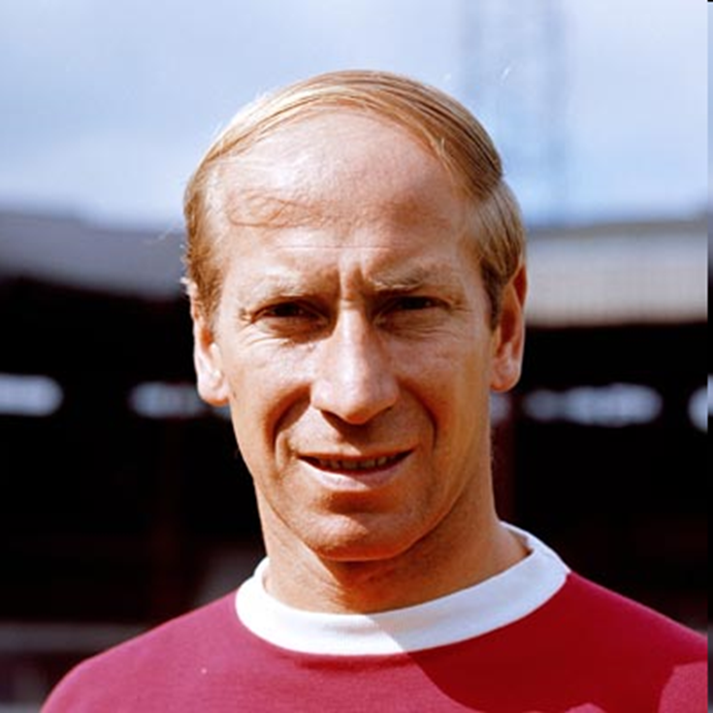

Slide 17

So always remember to be proud of all your achievements.

Slide 18
Prayer
Lord,
We thank you for all the talents and abilities that lie inside us. Help us to make the most of what you’ve given us, to work hard, and try to be better. May we celebrate our own achievements as well as those of our friends. Help us not to be envious of others, but always to be pleased when our friends do well. Help us to be PROUD.
Amen

