Slide 1
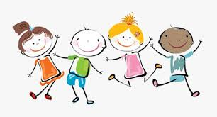
WELL BEING WEDNESDAY
WEEK SIX BE HAPPY!

Slide 2

Thank you for being such amazing children. You make me happy!
Thank you!

Slide 3

What do we do when we feel happy?

Slide 4
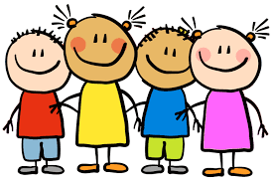
So what makes you feel happy?

Slide 5
One of your activities today is to list the things that make you happy.
Here are some of the things that make me happy…
Family
Friends
Coming to school and seeing all of you lovely lot
Coventry City winning
Pink Panther films
Going on holidays
Seeing a sunset

Slide 6
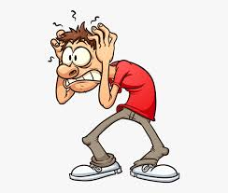
So what makes you feel anxious?

Slide 7
One of your activities today is to list the things that make you anxious.
Here are some of the things that make me feel anxious
Coventry City losing
When things don’t go to plan
Going on an aeroplane
Going to the dentist
Swimming in the sea

Slide 8

This is MR HAPPY…

Slide 9
LINK>>>>>>
With an adult’s permission click on this link to watch the story of Mr Happy.
https://www.youtube.com/watch?v=FMYzPBn63Ic

Slide 10
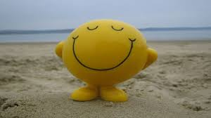
So when you feel anxious try to think HAPPY THOUGHTS.

Slide 11
Prayer
Lord,
We thank you for all of the things that make us happy.
When we feel worried or anxious, surround us in your love, and take care of us. Help us to feel happy.
Amen

