Slide 1
Welcome to
Class Thoresby

Slide 2
What’s New?
Behaviour system
Nut-free, healthy snacks
Yoga and well-being
Library cards & DEER time
Eco-committee

Slide 3
In school every day
Home learning book & organiser
Playtime snack
Water bottle
PE kit

Slide 4
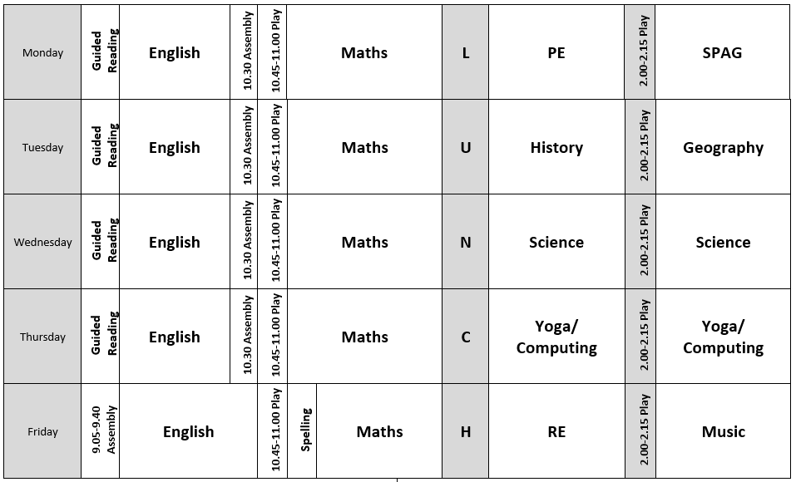

Slide 5
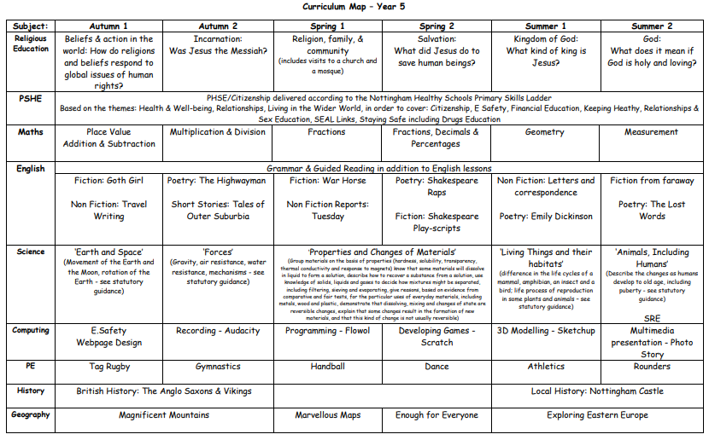

Slide 6
Expectations
Expectations are high – academic and behaviour
Upper Key Stage is a big jump from LKS2, particularly in English
Home Learning – little and often

Slide 7
KIRFs
One each half term linked to the maths being taught
For expected or exceeding mathematicians, these targets are essential
First target is to be fluent in times tables – something that is expected by end of Y4
Little and often – instant/quick recall

Slide 8
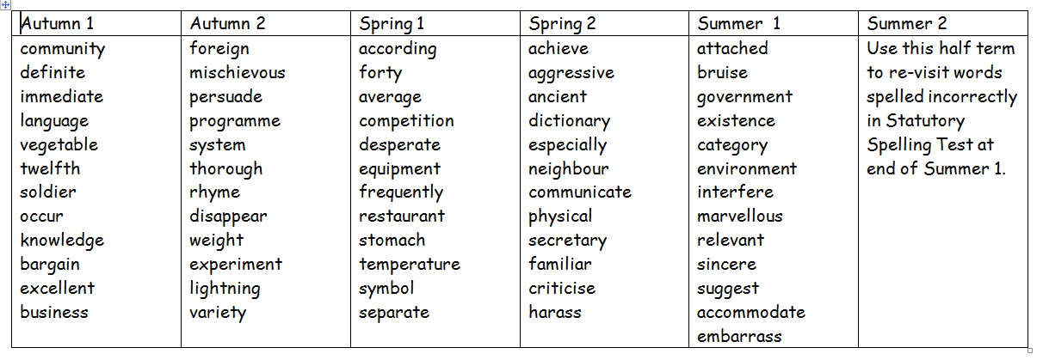
Statutory Spellings
Your child will also receive a weekly spelling list that follows a particular spelling pattern
Then need to be able to read and spell the word, as well as know the meaning

Slide 9
Reading
At least 4 times a week
PLEASE sign their organiser – this is a record of their reading
New library cards
Carlton Library
We are striving to create a reading culture and genuine love of books – we need your help.

Slide 10
Foundation Subjects
RE
History/Geography
PE
Art & Design
Music
Computing
DT

Slide 11
What else can you do?
Encourage independence outside of classroom
Encourage and support with Home Learning – expectations are high – thinking about secondary-ready (quality + quantity)
Support with trips/volunteering where possible
Contact me if there are any issues

Slide 12
Trips/Outings/ Visitors
National Space Centre - £15
Cinema
Mosque
Partake - £10
Hathersage - £120
Nottingham Castle?

Slide 13
Info from me to you
I will update web page as regularly as I can with photos and information
Please check it to see what is going on in Class Thoresby and keep up to date with information
I will use Parentmail to communicate
mmulqueen@hallows.notts.sch.uk

Slide 14

Any Questions?

