Slide 1

WELL BEING WEDNESDAY
WEEK SEVEN
STAYING FIT AND HEALTHY

Slide 2

Thank you for ANOTHER AMAZING WEEK!

Slide 3
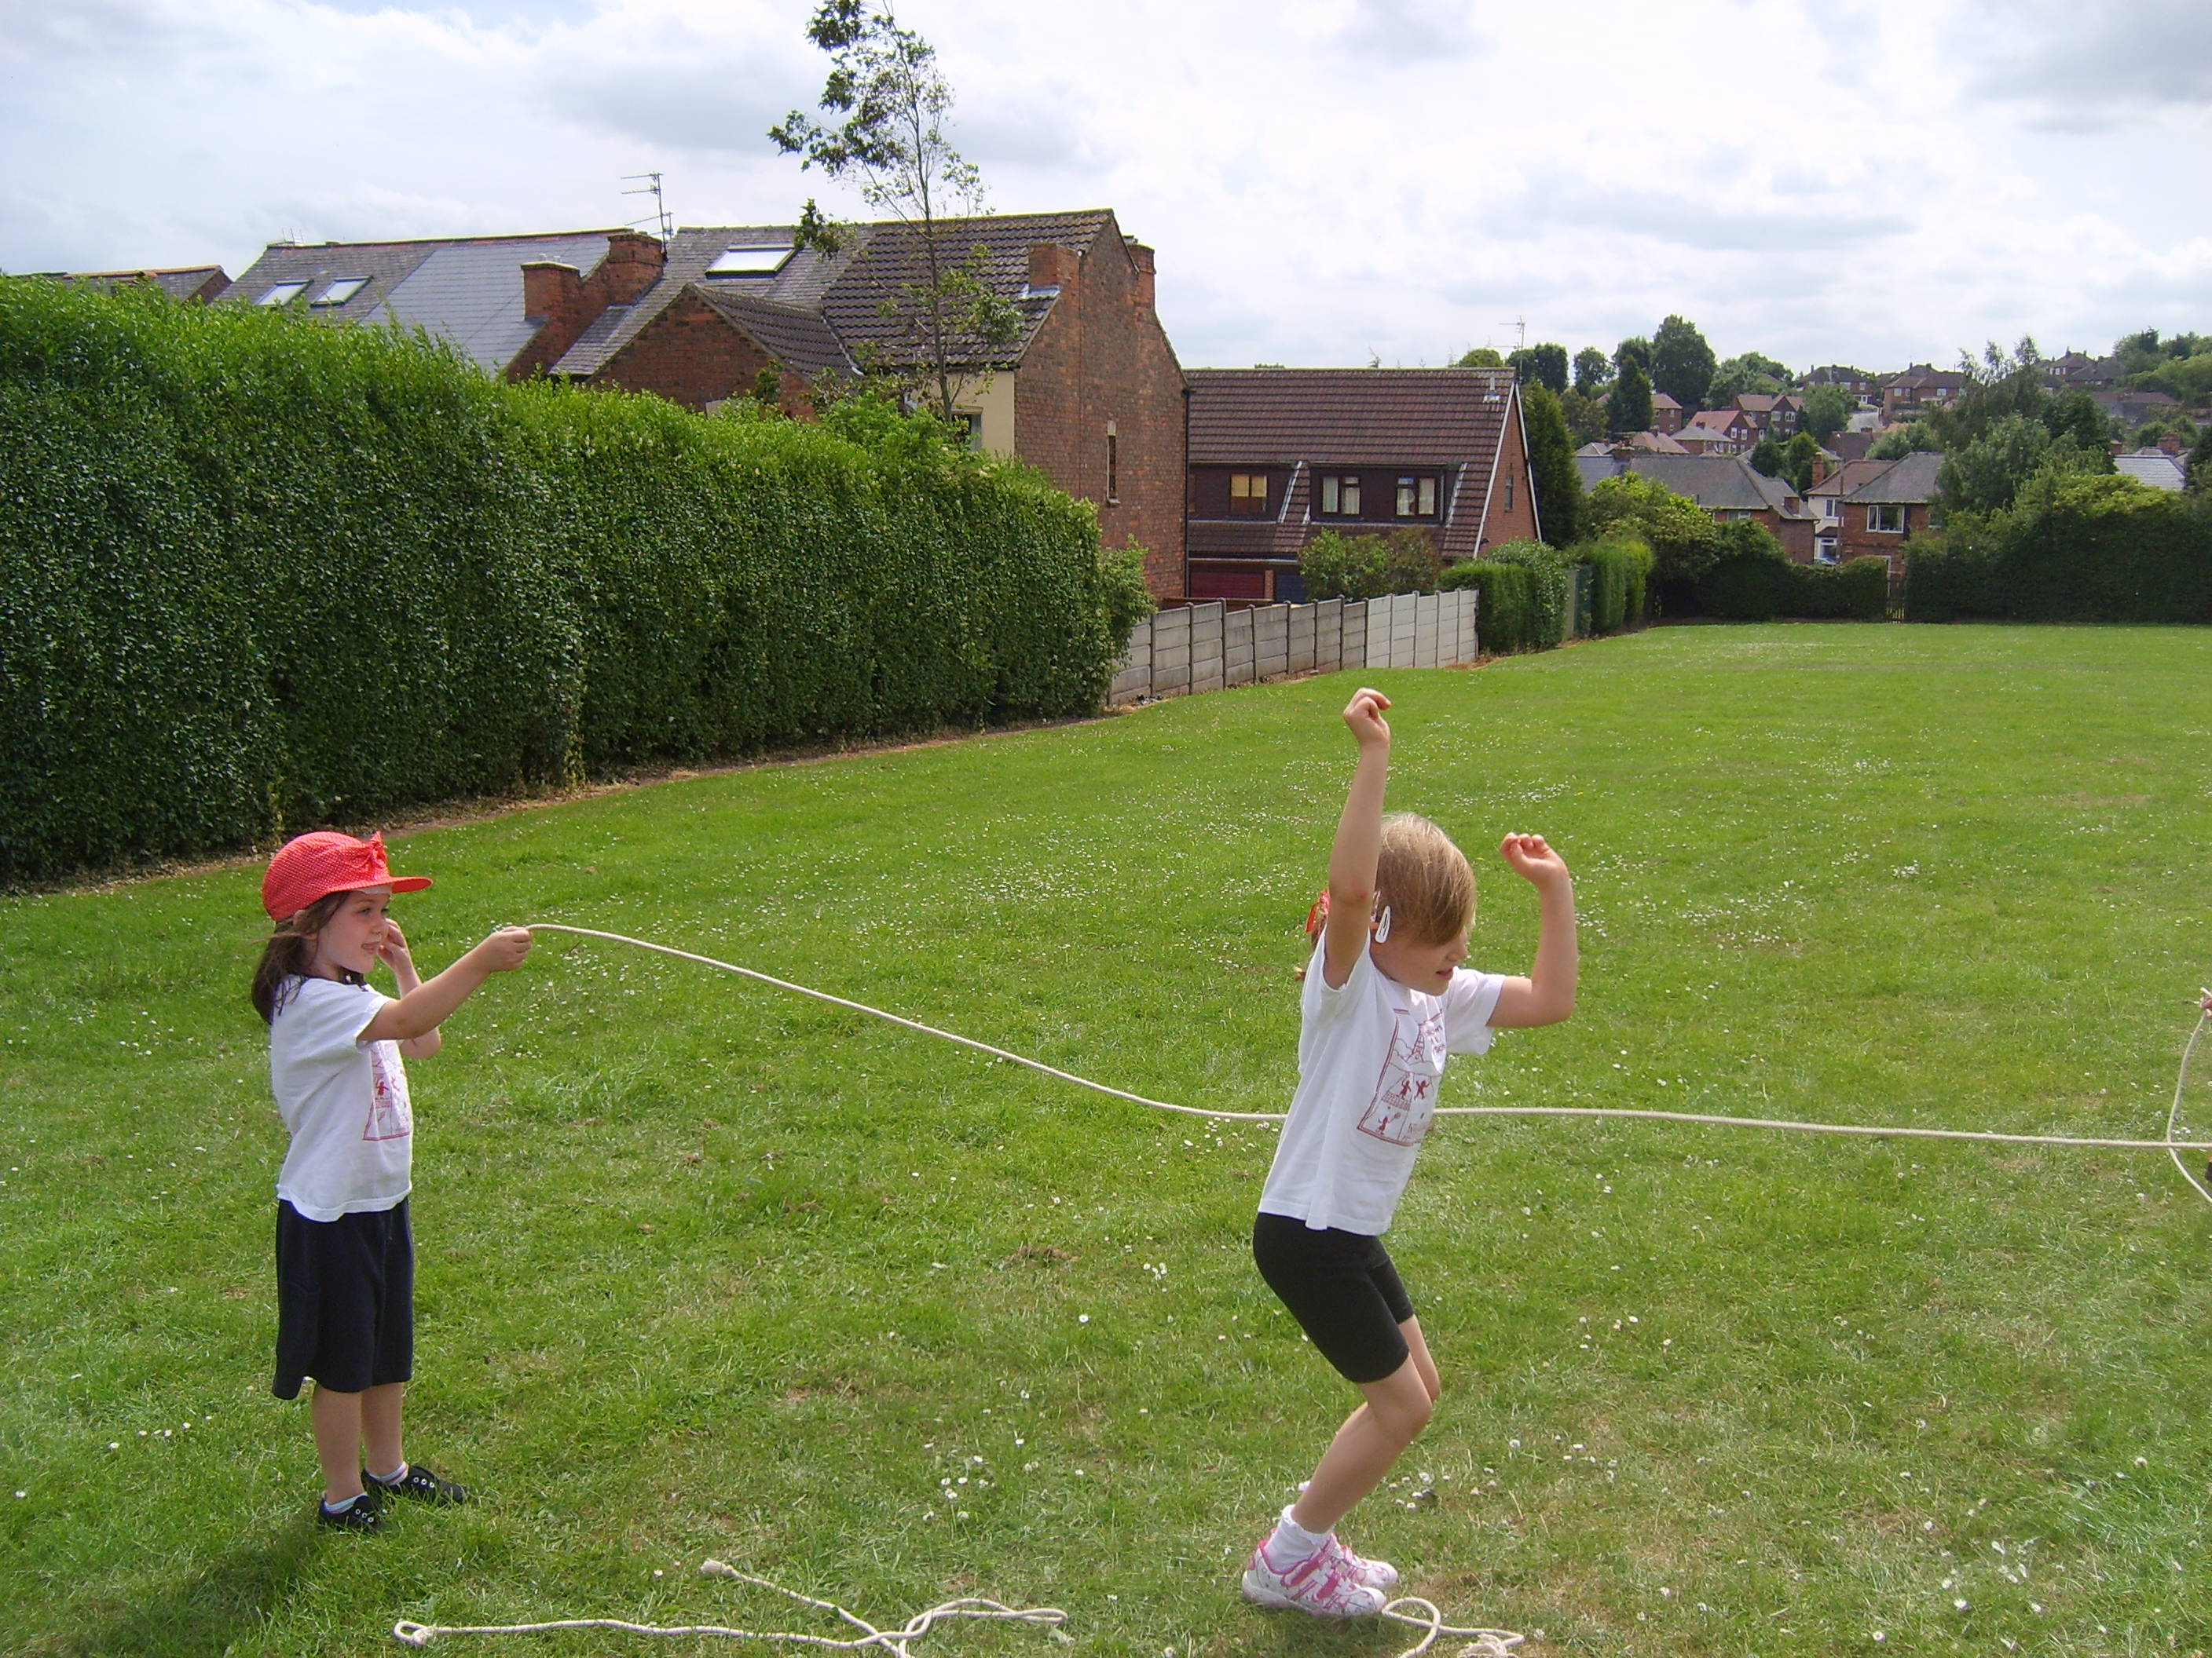
Did you know that we should be doing potted sports this week?

Slide 4
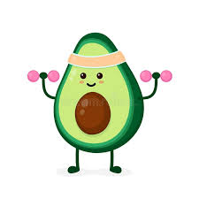
So you don’t miss out, your activity today involves doing your own sports!

Slide 5


Slide 6
Keeping fit
https://www.bbcchildreninneed.co.uk/schools/primary-school/joe-wicks-work-out-videos
You might be Joe Wicks’ed’ out but you can always try this link.

Slide 7

Enjoy our stay fit day!

Slide 8
Prayer
Lord,
We thank you for all of the opportunities to stay fit and healthy. Thank you for the opportunities to take part in sport and games.
Amen.

